Slide 1
MACHINE LEARNING
PART II

Slide 2
The answer for Quick Quiz…
SUPERVISED LEARNING
…because your goal is to predict a specific outcome (namely survival for each passenger.

Slide 3
Supervised Learning - Classification
For categorical response values, where the data can be separated into specific “classes”.
Supervised learning algorithm seeks to build a model that can make predictions of the response values for a new dataset.
Common classification algorithms include:
Support vector machines (SVM)
Neural networks
Naïve Bayes classifier
Decision trees
Discriminant analysis
Nearest neighbors (kNN)

Slide 4

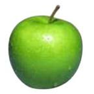
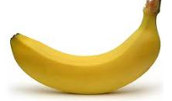
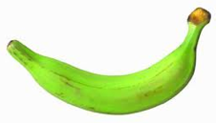
Supervised Learning - Classification
label
apple
Classification: a finite set of labels
apple
Supervised learning: given labeled examples
banana
banana

Slide 5
Supervised Learning - Regression
Target variables in regression must be continuous.
Regression has less or even no emphasis on
using probability to describe the random variation between the predictor and the target.
providing interpretable relationships between the predictors and targets.
Common regression algorithms include:
Ordinary Least Squares Regression (OLSR)
Linear Regression
Logistic Regression
Stepwise Regression
Multivariate Adaptive Regression Splines (MARS)
Locally Estimated Scatterplot Smoothing (LOESS)

Slide 6
Supervised Learning - Regression
label
-4.5
Regression: label is real-valued
10.1
Supervised learning: given labeled examples
3.2
4.3

Slide 7
How does machine learning work?
High-level steps of supervised learning:
First, train a machine learning model using labelled data.
“Labelled data” has been labelled with the outcome.
Machine learning model learns the relationship between the attributes of the data and its outcome.

Slide 8
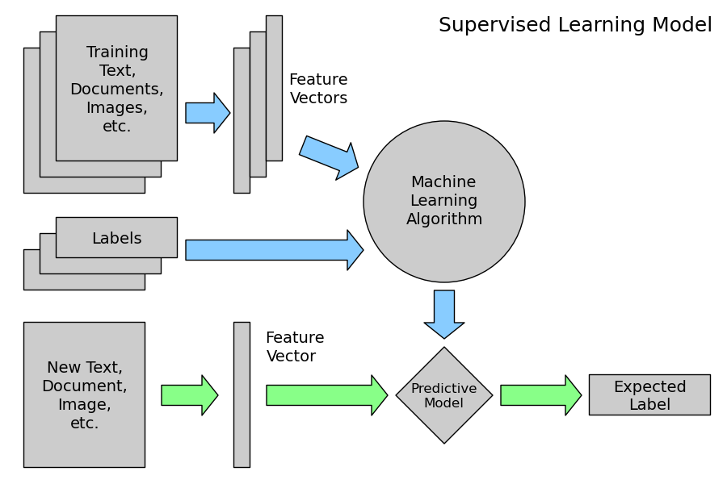
How does machine learning work?
Then, make predictions on new data for which the label is unknown
The primary goal of supervised learning is to build a model that “generalizes”. It accurately predicts the future rather than the past!

Slide 9
Unsupervised Learning - Clustering
Given a set of data points, each having a set of attributes, and a similarity measure among them, find clusters such that
data points in one cluster are more similar to one another
data points in separate clusters are less similar to one another.
Similarity measures
Euclidean distance if attributes are continuous

Slide 10
Unsupervised Learning - Clustering
Common clustering algorithms include:
Hierarchical clustering: builds a multilevel hierarchy of clusters by creating a cluster tree
k-Means clustering: partitions data into k distinct clusters based on distance to the centroid of a cluster
Gaussian mixture models: models clusters as a mixture of multivariate normal density components
Self-organizing maps: uses neural networks that learn the topology and distribution of the data
Hidden Markov models: uses observed data to recover the sequence of states

Slide 11
BREAK

